Slide 1


Slide 2



CRM & Email Marketing Integration
Allen Roth Director of Business Applications aroth@jcfcleve.org
Notes:
With me this year is Kavya Suram, the main developer on the project I’m about to present

Slide 3
Who is the Jewish Federation of Cleveland?
We are one of @150 Jewish Federations that make up the Jewish Federations of North America (JFNA)
The Jewish Federations raise and distribute more than $3 billion annually
Each Federation is independent, but we collaborate
Cleveland is one of the large Federations and a leader in the Federation “Collective”
All CRM enhancements are shared amongst the “Collective”
Notes:
Please note the last bullet. This effects everything we create for CRM

Slide 4
Project Background
Prior to September 2016 we used Lyris for Email Marketing. Our email database was comprised of approximately 32,000 unique email addresses, but over 320,000 subscriber records!
Marketing reached out to IT to improve our Email Marketing
We had 18 different email lists
Lists were populated via uploads from CRM for mailings
If an email was not on a list, it was added to that list by the upload
Not all addresses were valid
Lists became inflated, some over 20,000 subscribers each
Lists became non-relevant to their original purpose
Notes:
This slide gives you a bit of background on how we used to do our email marketing
I’m not going to focus on the marketing side, but as you can see, our email marketing had issues, and our IT department was asked to partner with Marketing to improve it

Slide 5




_____
After reviewing the data, in a 30-day period we had unsubscribe requests from over 2% of our total e-mail list!
_____
Notes:
To summarize the situation, in our previous email marketing paradigm, we would add every email address we identified, and get a high volume of unsubscribes and undeliverable emails.
In addition, there was virtually no visibility into what data was in the email marketing platform, nor how well or poorly an email marketing campaign did.
This was the problem that drove this project.

Slide 6
Project Goals
Increase email open and click rates
Reduce unsubscribes
Enable automated synchronization between CRM and the Email Marketing platform
Accommodate the collective, we could have 150 different platforms including BBIS or no platform
Make platform switching configurable!
Provide better reporting, analysis, and recommendations
Notes:
Of course, the marketing side is still the driving factor: we want to increase the email open and click rates and reduce unsubscribes by sending subscribers relevant email based on past history and defined email preferences.
How can we do that?
To start, accurate subscriber information must reside in both systems to allow more personalized, targeted email.
We want to automate certain email processes and ensure timely delivery of relevant information while also reducing manual effort.
And we want to do all this in a very flexible, configurable way so that other Federations could also benefit from our efforts

Slide 7
_____
Respect the preferences and privacy of subscribers, and do your best to respect the intent of a subscriber. Reduce assumption!
_____
Grow a new subscriber into a more engaged constituent through less frequent, more relevant email campaigns.
_____
Notes:
As part of this project we’ve shifted to providing only what the constituent is interested in, respecting their preferences
Instead of sending emails to everyone about everything that they didn’t explicitly ask us not to send them, we started to engage our constituents with less frequent, more targeted email campaigns.
As a result, our open rate percentages per mailing have increased
Now, so that we can better understand some of the integration challenges, let’s review some of the typical constructs involved in Email Marketing

Slide 8
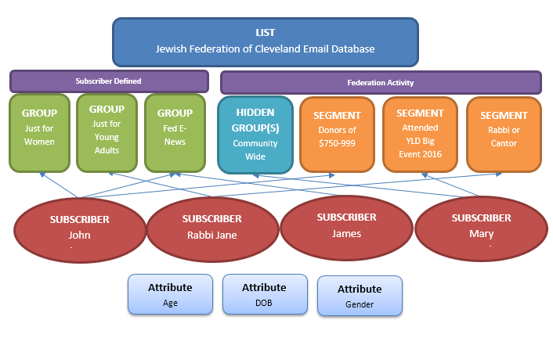
Typical Email List Components
Notes:
Email marketing platforms are driven off of lists of email addresses
An individual email address can be subscribed to one or more interests or groups
Those email addresses can be involved in logical groupings based on demographics, giving, or any criteria imaginable to form segments
And finally, each email address can have attributes associated to them. These are typically called list fields

Slide 9
_____
CRM tracks constituents,
Email marketing platforms track email addresses!
____
Notes:
This has was a large realization to make, and a challenge we had to overcome to correctly synchronize the two systems

Slide 10

Deliverability Opt-in versus Opt-out
Notes:
Our old model, “Opting Out,” was to send email to everyone in our database that met the intended demographic unless they explicitly asked to be removed from a list
Our new model “Opting In,” follows the constituents desires requesting them to opt-in to mailings
CRM’s current functionality supports the Opt-out model. We needed to create the customizations you’re about to see to facilitate opting in.
This had to flexible and accommodate whether they opted in or we opted someone in on their behalf

Slide 11

CRM Integration
Notes:
Now let’s talk about the actual customization
-----The design phase for our integration project began in February 2017
-----The design began only four months ago!

Slide 12
Driving Design Themes
Allow the solution to be flexible, but yet very “plug and play” so that it can be easily used with any Email Marketing platform including none.
Development needed to implement a new platform should be minimal.
Make it look as seamless, easy to use, and use as much out of the box functionality as possible.
Sync added and updated emails in both directions
Accurately reflect subscriber entered interests, but allow overrides to be entered in CRM
Reflect CRM biographical information to the subscriber
Update CRM with biographical information updates
Upload standard segments from CRM to the Email Marketing platform
Notes:
This slide summarizes the overall driving themes of this customization

Slide 13
Data Rules
Data updated in the Email Marketing (EM) platform takes priority over data in CRM
Any CRM email can be flagged as one that is in EM
We will not try to replicate all CRM constituent data to EM
Constituent data fields need to be configurable and flagged as to which system controls each field
“Standard” constituent segments will be created in CRM and synchronized to the EM platform
An email address can be shared between two constituents
Notes:
Data updated in the Email Marketing (EM) platform takes priority over data in CRM
It is presumed that these updates are being done by the constituent
Any CRM email can also reside in EM
There are various constituent related data points that can be exposed in the EM platform. We will only synchronize those fields
Each of those fields need to flagged as to which of the two systems or both can update that field for proper synchronization
As part of this project we have chosen to create standard constituent segments to help simplify email campaign creation
And finally, an email address can be shared between two constituents. This creates additional complexity

Slide 14
Demo Operational & Configuration

Slide 15
Code Architecture design

Slide 16
Synchronization Architecture
CRM to Email Marketing synchronization occurs via business processes.
Each business process calls a dedicated public CLR method that controls processing for that process.
Business Processes:
Add to CRM
Add to EM
Updates to CRM
Updates to EM
List Fields (attributes) to CRM
List Fields (attributes) to EM
Segments to EM
Get EM List Information (for configuration)

Slide 17

.Net Class Design
Notes:
Each business process calls a method in the “BbCrm” driving class on the left that controls the overall flow
The “BbCrm” class at run time instantiates the configured Email Marketing implementation class.
In this case the “MailChimp” class
That “MailChimp” Email Marketing implementation class inherits from an “EmailMarketing” abstract base class and implements defined interfaces

Slide 18
.Net Architecture
The BbCrm class and EmailMarketing abstract class reside in the same catalog and are written in VB.net
The concrete MailChimp class is in a separate catalog and is written in C#
The concrete MailChimp class is not directly referenced and is instantiated dynamically at runtime
Data is passed using dictionaries and lists
For the MailChimp platform implementation, that data is converted to JSON

Slide 19
Instantiating the class dynamically
'_assembly should equal projectName.className, projectName
Dim text As String = _assembly.ToString()
Dim type As System.Type = System.Type.[GetType](text, False, True)
Dim args As Object() = {_url, _userId, _password, _catalogs}
Dim objectValue As Object = System.Runtime.CompilerServices.RuntimeHelpers.GetObjectValue(System.Activator.CreateInstance(type, args))

Slide 20
Database Architecture
Challenge: How to keep track of what needs to be sync’d and in which direction?
Created an update queue table for queuing emails and list/interest subscriptions to EM
Every data form that changes data saves to this queue
Configuration interface allows an administrator to configure various attributes:
Enable or disable lists, interests, fields, etc.
Indicates lists that will allow unsubscribes from CRM
Mark fields as being updateable or not in EM
Identify email addresses that are shared between constituents

Slide 21
Future
Continue to build out all the identified Use Cases and their variants
Display email communications sent by constituent
Display email statistics by constituent
Integrate e-mail marketing information into our BI platform
Release this to other Federations
Work on our BBIS implementation, and revaluate our Email Marketing platform choice

Slide 22


Questions?

Slide 23
Thank you!
Allen Roth Director of Business Applications Jewish Federation of Cleveland aroth@jcfcleve.org

